Slide 1
Lecture 09 Recursion
CSE225: Data Structures

Slide 2
A Look Back at Functions
#include <stdio.h>
#include <math.h>
double distance(double x1, double y1, double x2, double y2)
{
double dist;
dist = sqrt((x1-x2)*(x1-x2)+(y1-y2)*(y1-y2));
return dist;
}
int main()
{
double milage = distance(0, 0, 3, 4);
printf("Milage: %lf\n",milage);
return 0;
}

Slide 3
A Look Back at Functions
#include <stdio.h>
#include <math.h>
double distance(double x1, double y1, double x2, double y2)
{
double dist;
dist = sqrt((x1-x2)*(x1-x2)+(y1-y2)*(y1-y2));
return dist;
}
int main()
{
double milage = distance(0, 0, 3, 4);
printf("Milage: %lf\n",milage);
return 0;
}
main

Slide 4
A Look Back at Functions
#include <stdio.h>
#include <math.h>
double distance(double x1, double y1, double x2, double y2)
{
double dist;
dist = sqrt((x1-x2)*(x1-x2)+(y1-y2)*(y1-y2));
return dist;
}
int main()
{
double milage = distance(0, 0, 3, 4);
printf("Milage: %lf\n",milage);
return 0;
}
main
distance
(0,0,3,4)

Slide 5
A Look Back at Functions
#include <stdio.h>
#include <math.h>
double distance(double x1, double y1, double x2, double y2)
{
double dist;
dist = sqrt((x1-x2)*(x1-x2)+(y1-y2)*(y1-y2));
return dist;
}
int main()
{
double milage = distance(0, 0, 3, 4);
printf("Milage: %lf\n",milage);
return 0;
}
main
distance
sqrt
(0,0,3,4)
(25)

Slide 6
A Look Back at Functions
#include <stdio.h>
#include <math.h>
double distance(double x1, double y1, double x2, double y2)
{
double dist;
dist = sqrt((x1-x2)*(x1-x2)+(y1-y2)*(y1-y2));
return dist;
}
int main()
{
double milage = distance(0, 0, 3, 4);
printf("Milage: %lf\n",milage);
return 0;
}
(5)
main
distance
sqrt
(0,0,3,4)
(25)

Slide 7
A Look Back at Functions
#include <stdio.h>
#include <math.h>
double distance(double x1, double y1, double x2, double y2)
{
double dist;
dist = sqrt((x1-x2)*(x1-x2)+(y1-y2)*(y1-y2));
return dist;
}
int main()
{
double milage = distance(0, 0, 3, 4);
printf("Milage: %lf\n",milage);
return 0;
}
(5)
main
distance
(0,0,3,4)

Slide 8
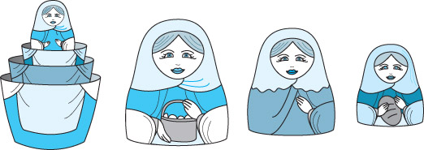
Recursion
Recursion is a technique that solves a problem by solving a smaller problem of the same type.
Recursion can be implemented using a recursive function (a function invoking itself, either directly or indirectly).
Recursion can be used as an alternative to iteration.
It is an important and powerful tool in problem solving and programming.
It is a programming technique that naturally implements the divide-and-conquer problem solving methodology.

Slide 9
Factorial – Iterative Definition
n! = n * (n-1) * (n-2) * … * 2 * 1 for any integer n>0
0! = 1
Iterative Definition in C:
fval = 1;
for (i = n; i >= 1; i--)
fval = fval * i;

Slide 10
Factorial – Recursive Definition
To define n! recursively, n! must be defined in terms of the factorial of a smaller number.
Observation (problem size is reduced):
n! = n * (n-1)!
Base case: 0! = 1
We can reach the base case, by subtracting 1 from n if n is a positive integer.
Recursive Definition:
n! = 1 if n = 0
n! = n*(n-1)! if n > 0

Slide 11
The Nature of Recursion
One or more simple cases of the problem (called the stopping cases or base case) have a simple non-recursive solution.
The other cases (general cases) of the problem can be reduced (using recursion) to problems that are closer to stopping cases.
Eventually the problem can be reduced to base cases only, which are relatively easy to solve.
In general:
if (base case)
solve it
else
reduce the problem using recursion // general case

Slide 12
Factorial of 4 (Recursive)
Calculate 4!
4! = 4 * (4-1)!
4! = 4 * 3!
4! = 4 * __

Slide 13
Factorial of 4 (Recursive)
Calculate 4!
4! = 4 * (4-1)!
4! = 4 * 3!
4! = 4 * __
Calculate 3!
3! = 3 * (3-1)!
3! = 3 * 2!
3! = 3 * __

Slide 14
Factorial of 4 (Recursive)
Calculate 4!
4! = 4 * (4-1)!
4! = 4 * 3!
4! = 4 * __
Calculate 3!
3! = 3 * (3-1)!
3! = 3 * 2!
3! = 3 * __
Calculate 2!
2! = 2 * (2-1)!
2! = 2 * 1!
2! = 2 * __

Slide 15
Factorial of 4 (Recursive)
Calculate 4!
4! = 4 * (4-1)!
4! = 4 * 3!
4! = 4 * __
Calculate 3!
3! = 3 * (3-1)!
3! = 3 * 2!
3! = 3 * __
Calculate 2!
2! = 2 * (2-1)!
2! = 2 * 1!
2! = 2 * __
Calculate 1!
1! = 1 * (1-1)!
1! = 1 * 0!
1! = 1 * __

Slide 16
Factorial of 4 (Recursive)
Calculate 4!
4! = 4 * (4-1)!
4! = 4 * 3!
4! = 4 * __
Calculate 3!
3! = 3 * (3-1)!
3! = 3 * 2!
3! = 3 * __
Calculate 2!
2! = 2 * (2-1)!
2! = 2 * 1!
2! = 2 * __
Calculate 1!
1! = 1 * (1-1)!
1! = 1 * 0!
1! = 1 * __
Calculate 0!
0! = 1

Slide 17
Factorial of 4 (Recursive)
Calculate 4!
4! = 4 * (4-1)!
4! = 4 * 3!
4! = 4 * __
Calculate 3!
3! = 3 * (3-1)!
3! = 3 * 2!
3! = 3 * __
Calculate 2!
2! = 2 * (2-1)!
2! = 2 * 1!
2! = 2 * __
Calculate 1!
1! = 1 * (1-1)!
1! = 1 * 0!
1! = 1 * 1
1! = 1

Slide 18
Factorial of 4 (Recursive)
Calculate 4!
4! = 4 * (4-1)!
4! = 4 * 3!
4! = 4 * __
Calculate 3!
3! = 3 * (3-1)!
3! = 3 * 2!
3! = 3 * __
Calculate 2!
2! = 2 * (2-1)!
2! = 2 * 1!
2! = 2 * 1
2! = 2

Slide 19
Factorial of 4 (Recursive)
Calculate 4!
4! = 4 * (4-1)!
4! = 4 * 3!
4! = 4 * __
Calculate 3!
3! = 3 * (3-1)!
3! = 3 * 2!
3! = 3 * 2
3! = 6

Slide 20
Factorial of 4 (Recursive)
Calculate 4!
4! = 4 * (4-1)!
4! = 4 * 3!
4! = 4 * 6
4! = 24

Slide 21
Recursive Factorial Function
// Computes the factorial of a nonnegative integer.
// Precondition: n must be greater than or equal to 0.
// Postcondition: Returns the factorial of n; n is unchanged.
int Factorial(int n)
{
if (n ==0)
return (1);
else
return (n * Factorial(n-1));
}

Slide 22
Tracing Factorial(4)
Factorial(4)

Slide 23
Tracing Factorial(4)
Factorial(4)
call
Factorial (4)

Slide 24
Tracing Factorial(4)
Factorial(4) = 4 * Factorial(3)
call
Factorial (4)
call
Factorial (3)

Slide 25
Tracing Factorial(4)
Factorial(4) = 4 * Factorial(3)
= 4 * (3 * Factorial(2))
call
Factorial (4)
call
Factorial (3)
call
Factorial (2)

Slide 26
Tracing Factorial(4)
Factorial(4) = 4 * Factorial(3)
= 4 * (3 * Factorial(2))
= 4 * (3 * (2 * Factorial(1)))
call
Factorial (4)
call
Factorial (3)
call
Factorial (2)
call
Factorial (1)

Slide 27
Tracing Factorial(4)
Factorial(4) = 4 * Factorial(3)
= 4 * (3 * Factorial(2))
= 4 * (3 * (2 * Factorial(1)))
= 4 * (3 * (2 * (1 * Factorial(0))))
call
Factorial (4)
call
Factorial (3)
call
Factorial (2)
call
Factorial (1)
call
Factorial (0)

Slide 28
Tracing Factorial(4)
Factorial(4) = 4 * Factorial(3)
= 4 * (3 * Factorial(2))
= 4 * (3 * (2 * Factorial(1)))
= 4 * (3 * (2 * (1 * Factorial(0))))
= 4 * (3 * (2 * (1 * 1)))
call
Factorial (4)
call
Factorial (3)
call
Factorial (2)
call
Factorial (1)
return
call
1
Factorial (0)

Slide 29
Tracing Factorial(4)
Factorial(4) = 4 * Factorial(3)
= 4 * (3 * Factorial(2))
= 4 * (3 * (2 * Factorial(1)))
= 4 * (3 * (2 * (1 * Factorial(0))))
= 4 * (3 * (2 * (1 * 1)))
= 4 * (3 * (2 * 1))
call
Factorial (4)
call
Factorial (3)
call
Factorial (2)
return
1
*
call
1
=
1
Factorial (1)
return
call
1
Factorial (0)

Slide 30
Tracing Factorial(4)
Factorial(4) = 4 * Factorial(3)
= 4 * (3 * Factorial(2))
= 4 * (3 * (2 * Factorial(1)))
= 4 * (3 * (2 * (1 * Factorial(0))))
= 4 * (3 * (2 * (1 * 1)))
= 4 * (3 * (2 * 1))
= 4 * (3 * 2)
call
Factorial (4)
call
Factorial (3)
return
2
*
call
1
=
2
Factorial (2)
return
1
*
call
1
=
1
Factorial (1)
return
call
1
Factorial (0)

Slide 31
Tracing Factorial(4)
Factorial(4) = 4 * Factorial(3)
= 4 * (3 * Factorial(2))
= 4 * (3 * (2 * Factorial(1)))
= 4 * (3 * (2 * (1 * Factorial(0))))
= 4 * (3 * (2 * (1 * 1)))
= 4 * (3 * (2 * 1))
= 4 * (3 * 2)
= 4 * 6
call
Factorial (4)
return
3
*
call
2
=
6
Factorial (3)
return
2
*
call
1
=
2
Factorial (2)
return
1
*
call
1
=
1
Factorial (1)
return
call
1
Factorial (0)

Slide 32
Tracing Factorial(4)
Factorial(4) = 4 * Factorial(3)
= 4 * (3 * Factorial(2))
= 4 * (3 * (2 * Factorial(1)))
= 4 * (3 * (2 * (1 * Factorial(0))))
= 4 * (3 * (2 * (1 * 1)))
= 4 * (3 * (2 * 1))
= 4 * (3 * 2)
= 4 * 6
= 24
return
4
*
call
6
=
24
final answer
Factorial (4)
return
3
*
call
2
=
6
Factorial (3)
return
2
*
call
1
=
2
Factorial (2)
return
1
*
call
1
=
1
Factorial (1)
return
call
1
Factorial (0)

Slide 33
A Couple of Things You Should Know
A stack is used to keep track of function calls.
Whenever a new function is called, all its parameters and local variables are pushed onto the stack along with the memory address of the calling statement (this gives the computer the return point after execution of the function)

Slide 34
Pitfalls of Recursion
If the recursion never reaches the base case, the recursive calls will continue until the computer runs out of memory and the program crashes. Experienced programmers try to examine the remains of a crash. The message “stack overflow error” or “heap storage exhaustion” indicates a possible runaway recursion.
When programming recursively, you need to make sure that the algorithm is moving toward the base case. Each successive call of the algorithm must be solving a simpler version of the problem.
Any recursive algorithm can be implemented iteratively, but sometimes only with great difficulty. However, a recursive solution will always run more slowly than an iterative one because of the overhead of opening and closing the recursive calls.

Slide 35
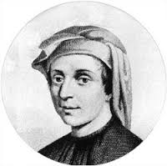
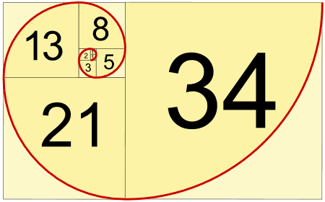
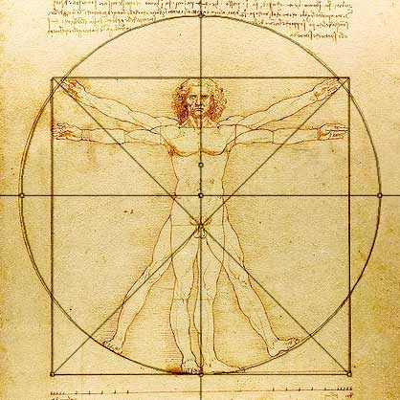
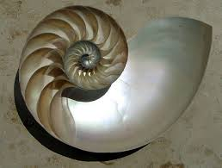
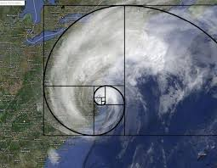
Fibonacci’s Problem
“Fibonacci” (Leonardo de Pisa) 1170-1240

Slide 36


Fibonacci’s Problem

Slide 37
Rabbit Rules
All pairs of rabbits consist of a male and female
One pair of newborn rabbits is placed in hutch on January 1
When this pair is 2 months old they produce a pair of baby rabbits
Every month afterwards they produce another pair
All rabbits produce pairs in the same manner
Rabbits don’t die

Slide 38
Fibonacci’s Problem
How many pairs of rabbits will there be 12 months later?

Slide 39


Jan 1
0
1
Feb 1
2
Mar 1
0

Slide 40

2
Mar 1
0
Apr 1
3
1
0
4
May 1
2
1
0
0

Slide 41
3
1
0
Apr 1
4
2
1
0
0
May 1
5
3
2
1
1
June 1

Slide 42
In General,
Pairs this month
Pairs last month
Pairs of newborns
=
+
Pairs this month
Pairs last month
Pairs 2 months ago
=
+
Notes:
See recursion?

Slide 43
Fibonacci Numbers
0, 1, 1, 2, 3, 5, 8, 13, 21, 34, ...
where each number is the sum of the preceding two.
Recursive definition:
F(0) = 0;
F(1) = 1;
F(number) = F(number-1)+ F(number-2);

Slide 44
Fibonacci Numbers
int Fibonacci(int n)
{
if(n == 0)
return 0;
else if (n == 1)
return 1;
else
return Fibonacci(n-1)+Fibonacci(n-2);
}

Slide 45
Fibonacci Numbers
int Fibonacci(int n)
{
if(n == 0)
return 0;
else if (n == 1)
return 1;
else
return Fibonacci(n-1)+Fibonacci(n-2);
}
Base case

Slide 46
Fibonacci Numbers
int Fibonacci(int n)
{
if(n == 0)
return 0;
else if (n == 1)
return 1;
else
return Fibonacci(n-1)+Fibonacci(n-2);
}
General
case

Slide 47
Tracing Fibonacci(5)
F(5)
Return F(4)+F(3)
5
3
2
F(4)
Return F(3)+F(2)
F(3)
Return F(2)+F(1)
2
1
1
1
F(3)
Return F(2)+F(1)
F(2)
Return F(1)+F(0)
F(2)
Return F(1)+F(0)
F(1)
Return 1
1
1
1
0
1
0
F(2)
Return F(1)+F(0)
F(1)
Return 1
F(1)
Return 1
F(0)
Return 0
F(1)
Return 1
F(0)
Return 0
1
0
F(1)
Return 1
F(0)
Return 0

Slide 48
Another Example: n choose r (combinations)
Given n things, how many different sets of size k can be chosen?
with base cases:

Slide 49
n choose r (Combinations)
int Combinations(int n, int r)
{
if(r == 1) // base case 1
return n;
else if (n == r) // base case 2
return 1;
else //general case
return(Combinations(n-1, r-1) + Combinations(n-1, r));
}

Slide 50
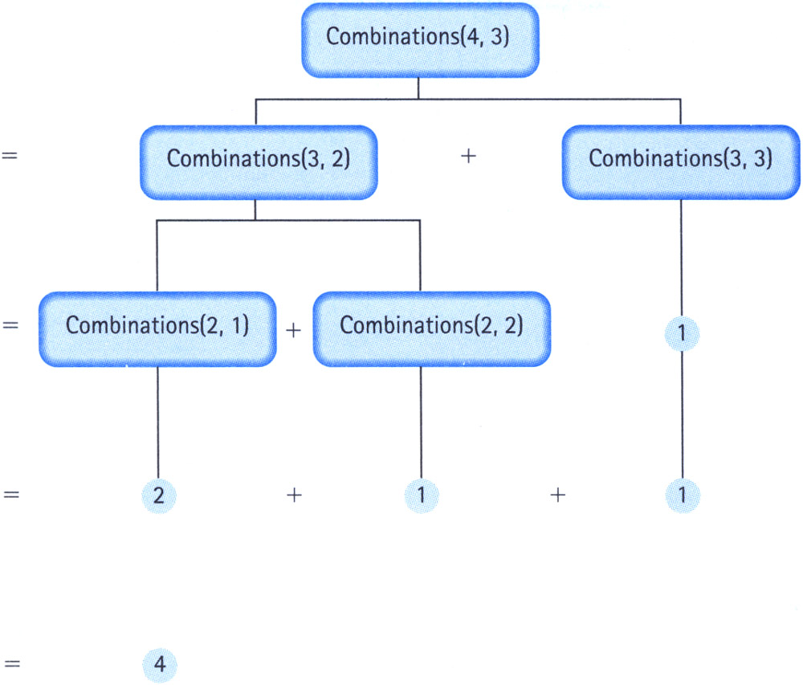
Tracing Combinations(4,3)

